Slide 1
Arduino Intro & Digital!

Slide 2
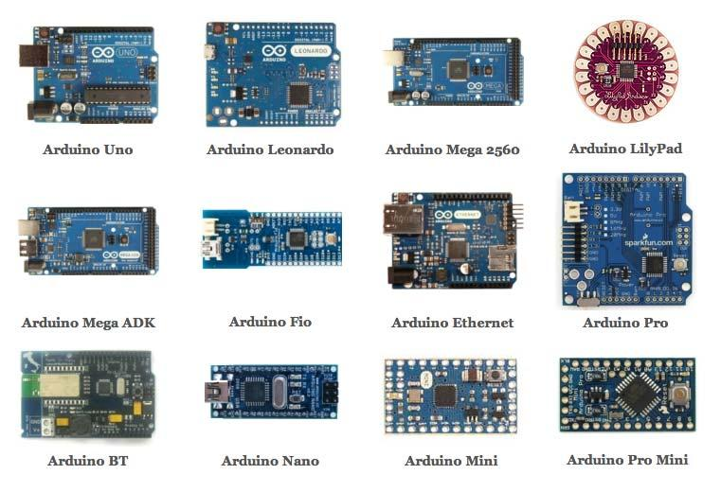
What is Arduino
An open-source platform ?
Based on an easy-to-use hardware and software
User friendly Development Environment (IDE)
Created for teaching electronics to artists and designers.
Low cost (~ 400 INR)
A Microcontroller?

Slide 3
Board Overview
Microcontroller
Crystal Oscillator
Power Pins
Analog Pins
Digital Pins
Tx-Rx Pins
Reset Button

Slide 4
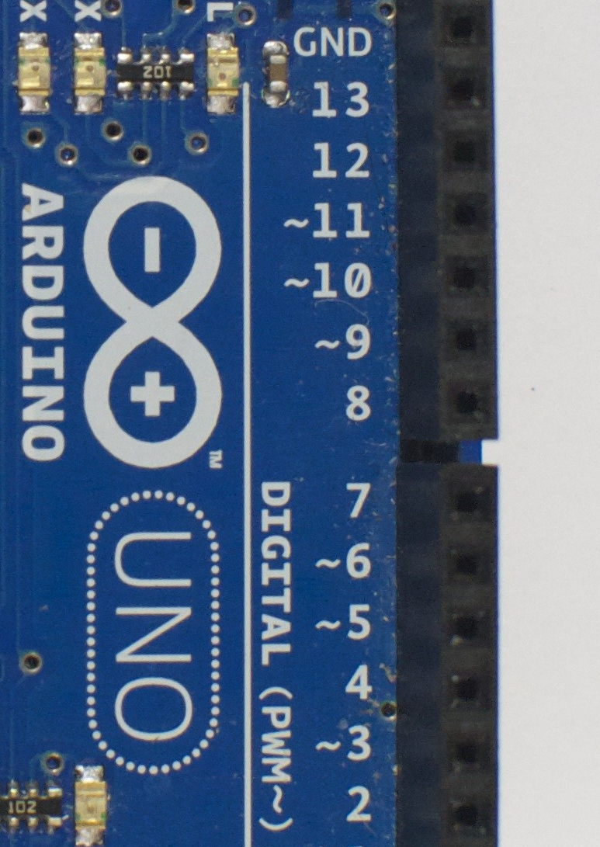
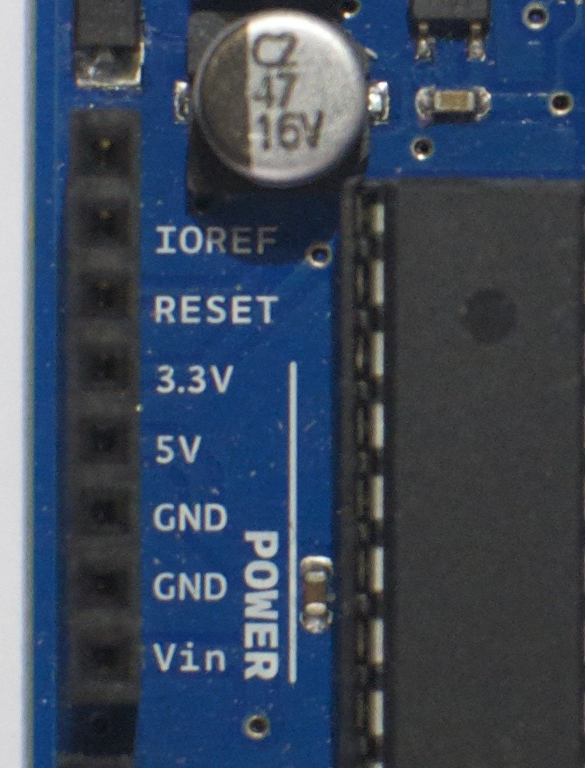
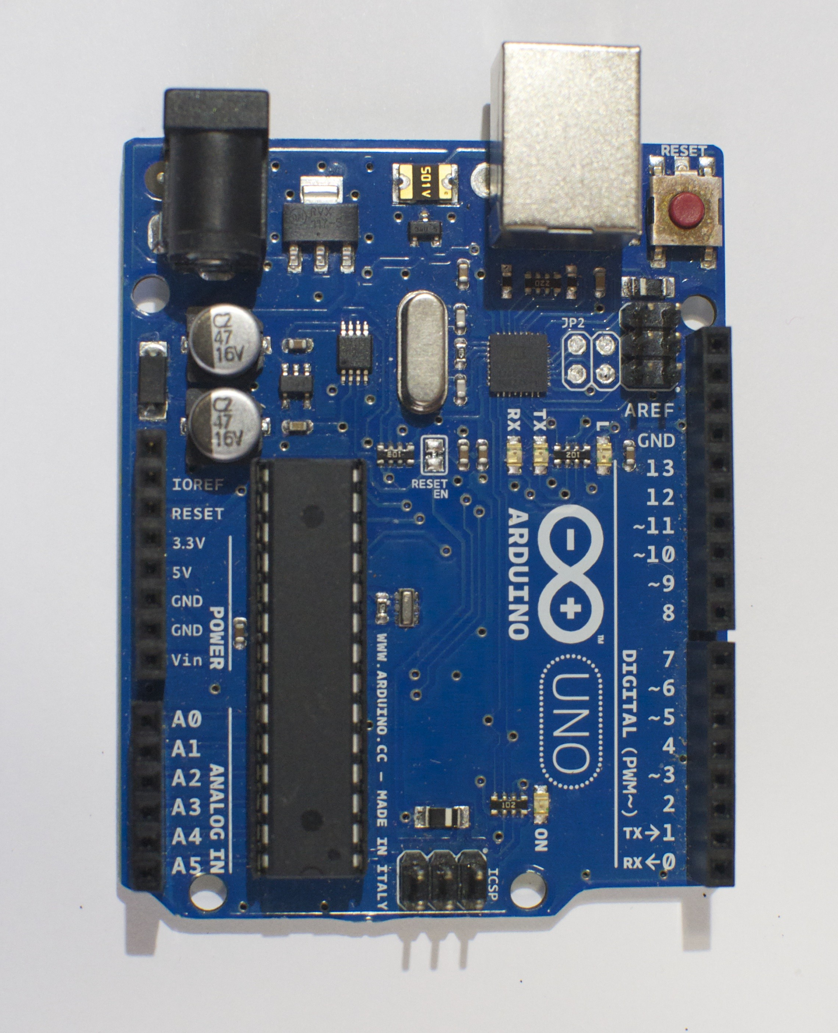
Power & Digital Pins
Power Pins
Digital Pins

Slide 5
Digital Pins
5 V
1
Logic Levels:
0
1
How High?
Logic Families:
CMOS
TTL
ECL
RTL
DTL
and A lot more
How Low?
0 V
0

Slide 6
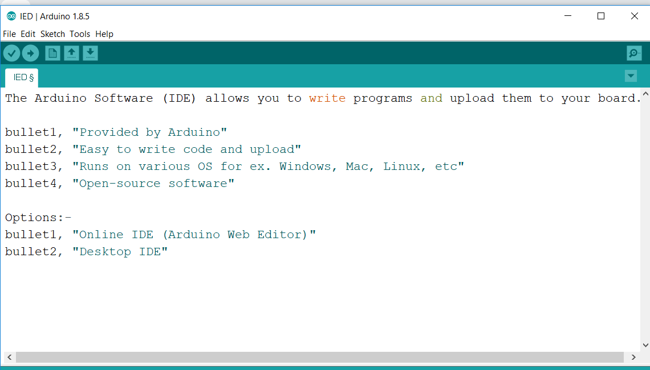
Arduino IDE

Slide 7
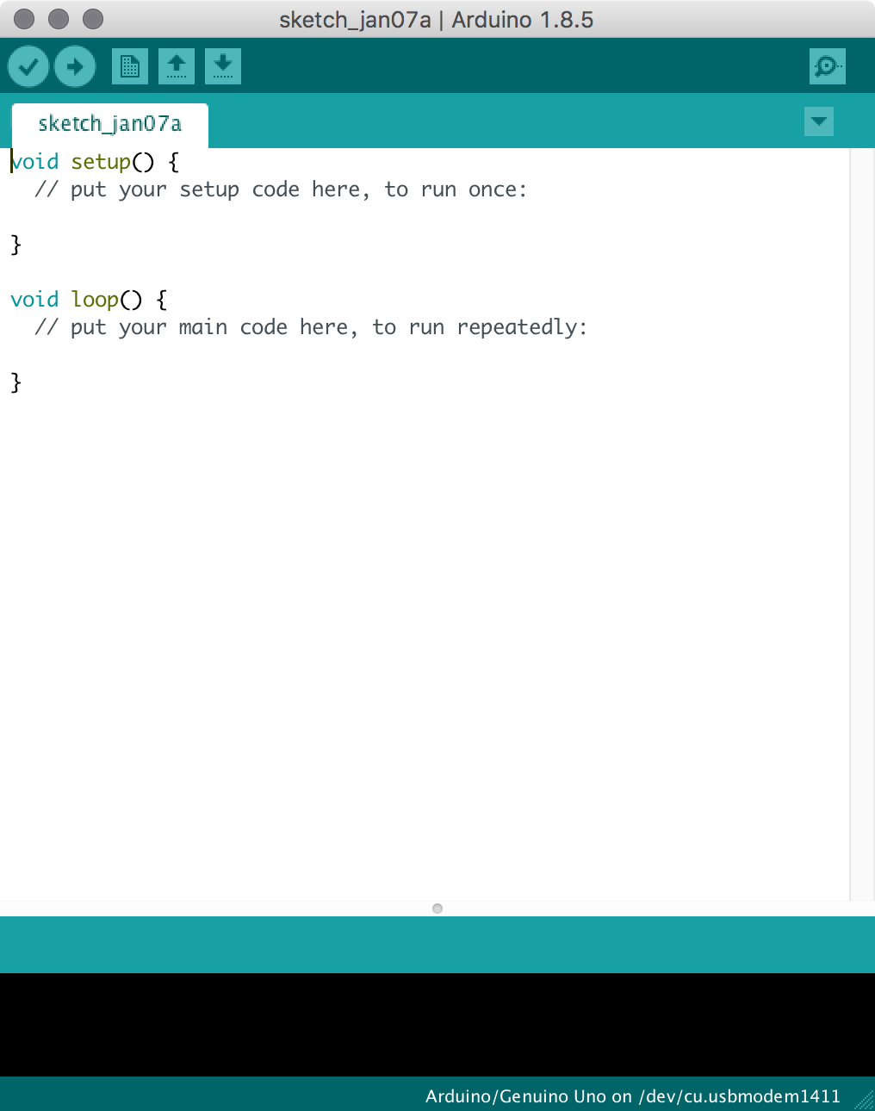
Arduino IDE
Sketch Name: This shows the name of the sketch you are currently working on.
New: This buttons opens up a new code window tab.
Open: This button will let you open up an existing sketch.
Save: This saves the currently active sketch.
Verify: Compiles and approves your code. It will catch errors in syntax (like missing semicolons or parenthesis).
Upload: Sends your code to the Arduino board. When you click it, you should see the lights on your board blink rapidly.
Code Area: This is the area where you compose the code for your sketch.
Message Area: This is where the IDE tells you if there were any errors in your code.
Text Console: The text console shows complete error messages. When debugging, the text console is very useful.
Board and Serial Port: Shows you what board and the serial port selections
Serial Monitor: This will open a window that displays any serial information your Arduino is transmitting. It is very useful for debugging.
5
6
2
3
4
11
1
7
8
9
10

Slide 8
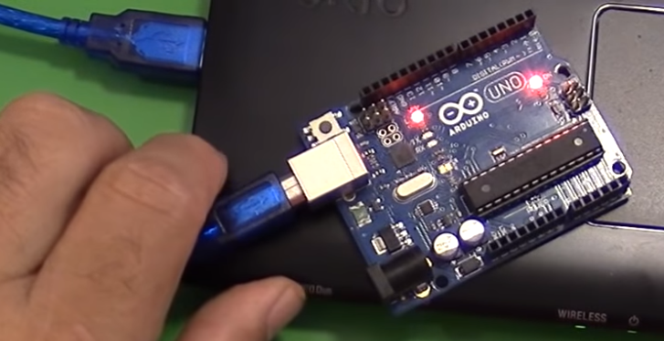
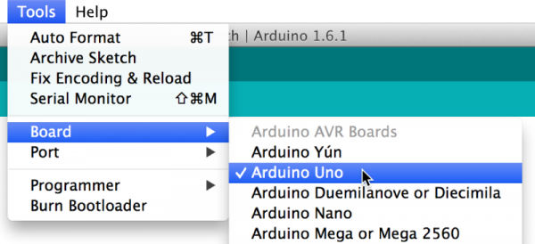
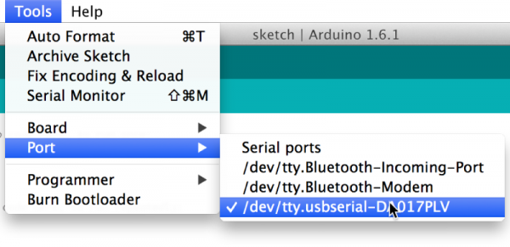
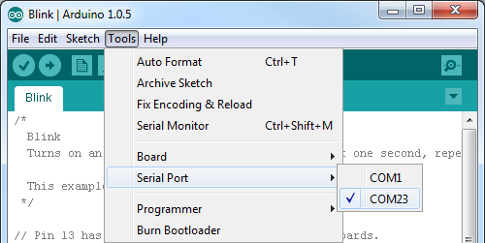
Board and Port Selection
Connect your board to PC using USB
2. Select the board
3. (MAC) Select the port
3. (Windows) Select the port

Slide 9
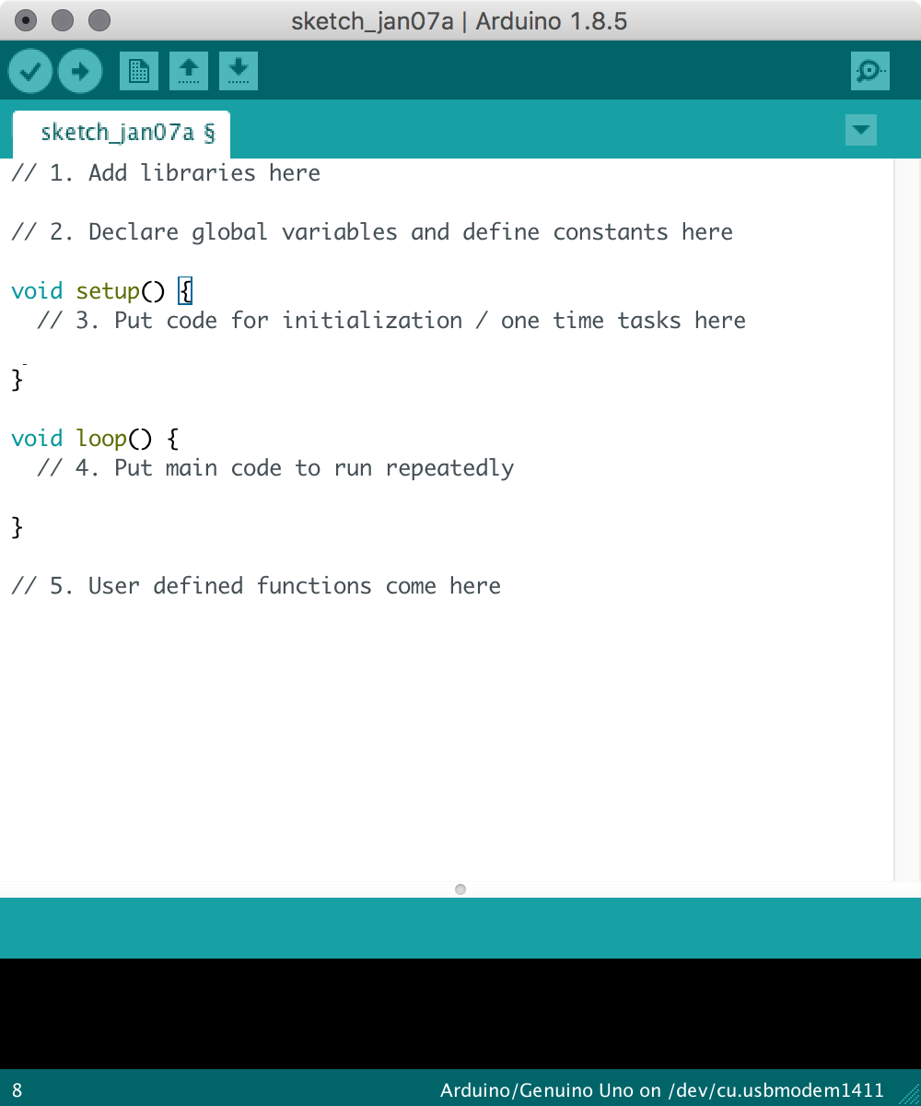
Code Basics

Slide 10
ACTIVITY 1
Blinking LED

Slide 11
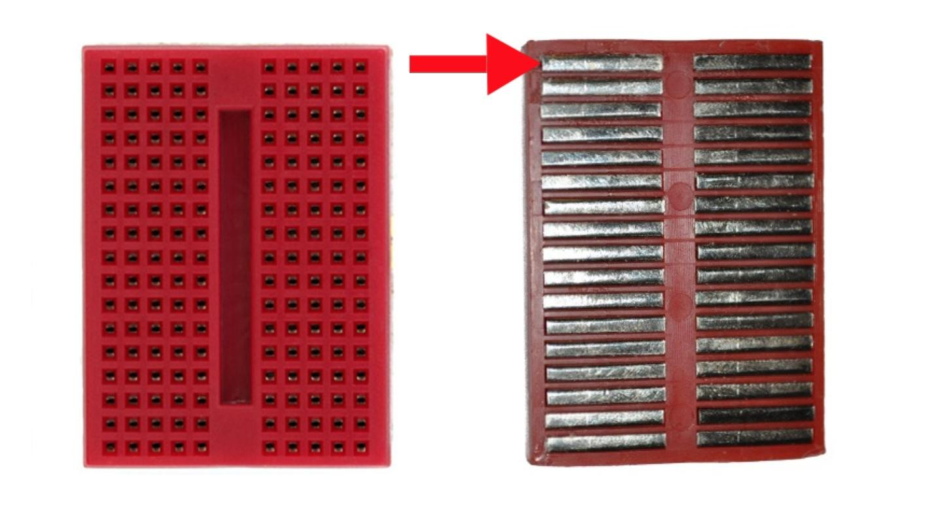

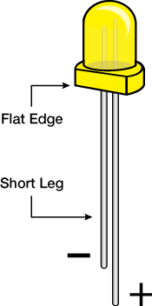
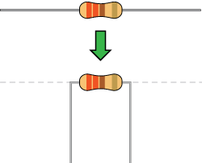
Step 1: What You Will Need

Slide 12
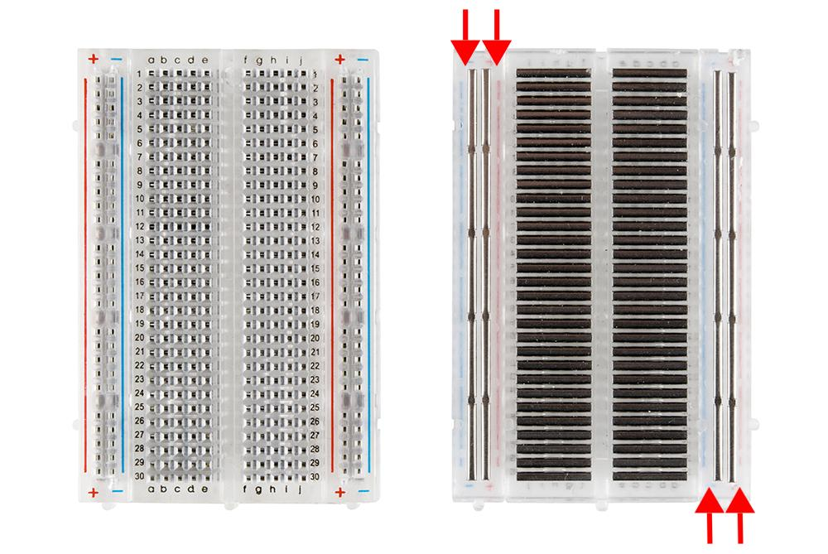
Breadboard Connections
Front view
Rear view
Source: https://cdn.sparkfun.com/assets/e/7/7/e/c/5175c500ce395f5a49000004.jpg
Source: https://cdn.sparkfun.com/assets/3/d/f/a/9/518c0b34ce395fea62000002.jpg

Slide 13
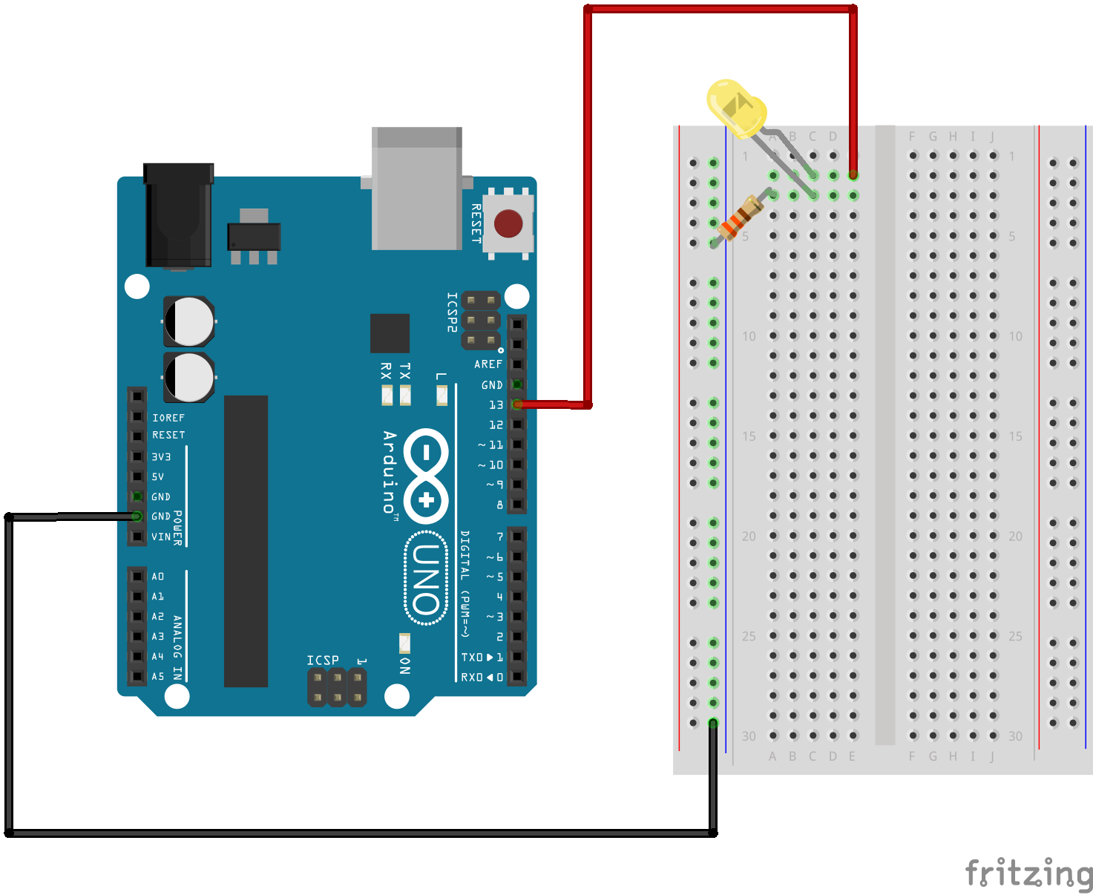
Step 2: The Circuit

Slide 14
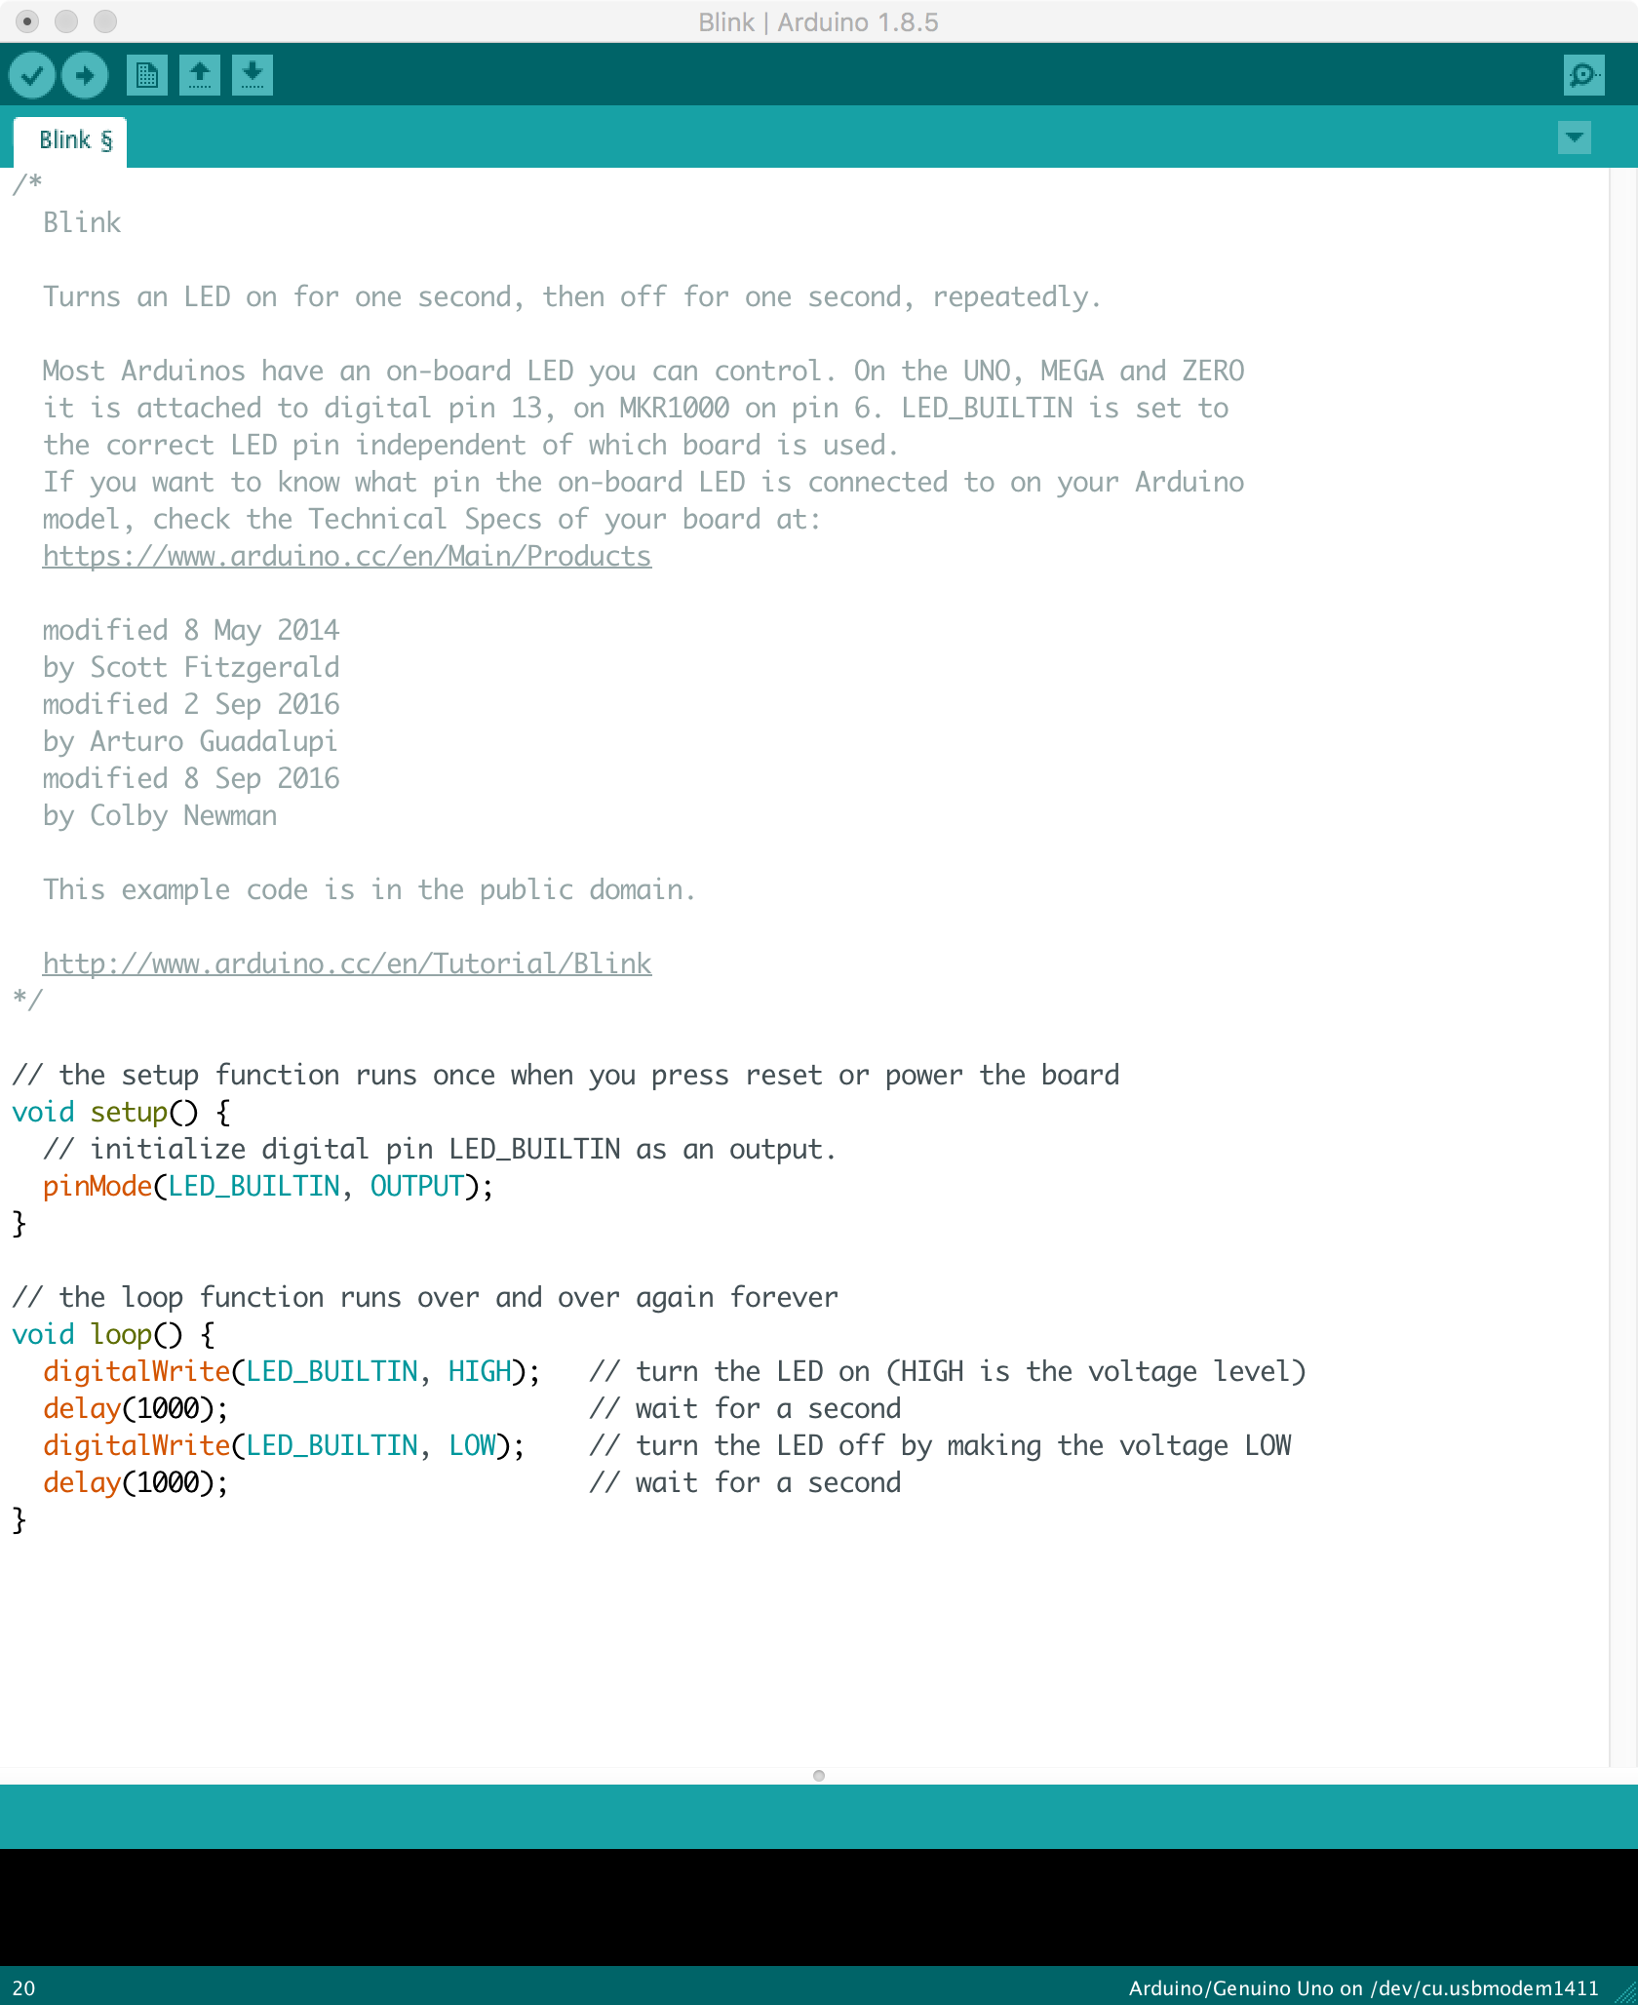
Step 3: The Code

Slide 15
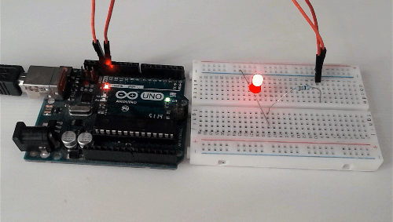
Expected Output
Source: https://www.electronicwings.com/public/images/user_images/images/Arduino/Using%20Arduino%20IDE/Arduino_LED.gif

Slide 16
ACTIVITY 2
ON/OFF LED Using Pushbutton

Slide 17
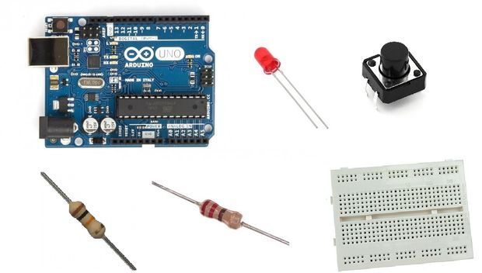
Step 1: What You Will Need
Arduino uno
Breadboard
LED
220 Ohm & 10K Ohm resistor
Push button

Slide 18
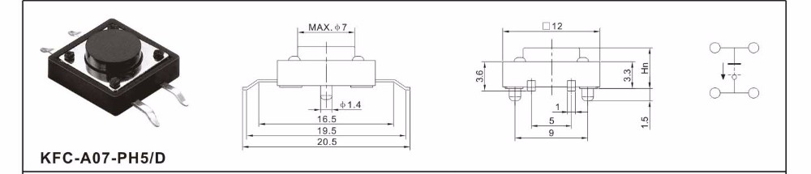

Push button Working
Expected
Behaviour
How can you see it?
Be Aware
Bouncing/Debouncing
Actual
Switch

Slide 19
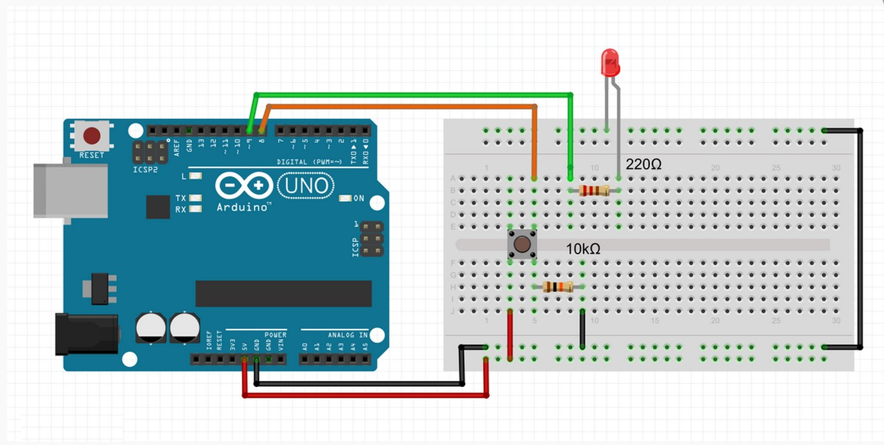
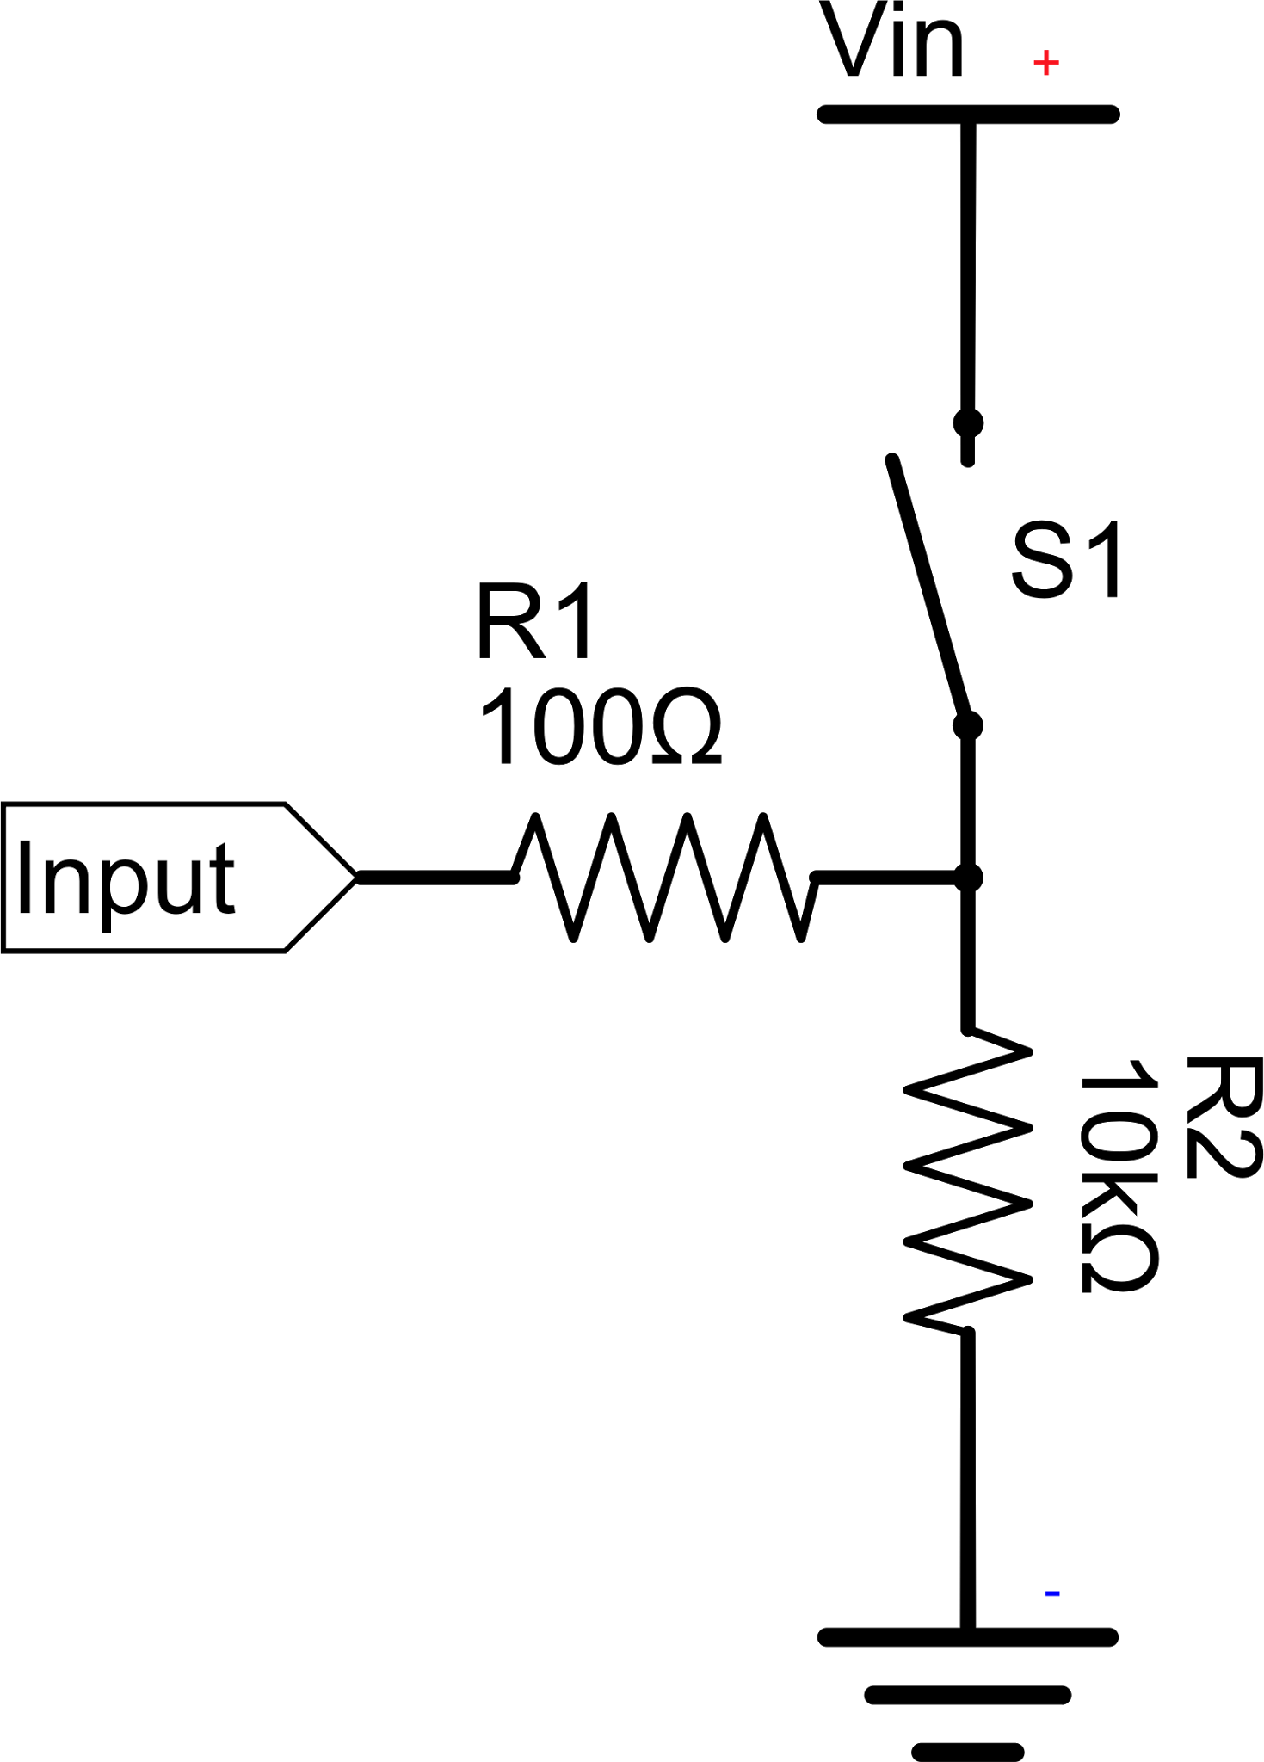
Step 2: The Circuit
Pull down resistor
*Source Credits: http://www.instructables.com/id/How-to-use-a-Push-Button-Arduino-Tutorial/

